Slide 1
ECE 355: Software Engineering
CHAPTER 2
Unit 4 (Part 2)
Presentation material based on past ECE 355 notes by Prof. K. Czarneszki.

Slide 2
Course outline
Unit 1: Software Engineering Basics
Unit 2: Process Models and Software Life Cycles
Unit 3: Software Requirements
→ Unit 4: Unified Modeling Language (UML)
Unit 5: Design Basics and Software Architecture
Unit 6: OO Analysis and Design
Unit 7: Design Patterns
Unit 8: Testing and Reliability
Unit 9: Software Engineering Management and Economics

Slide 3
UML - Outline
Introduction
Behavioral modeling
Structural modeling
  Static structural diagrams
    Class diagrams
    Object diagrams
  Implementation diagrams
    Component diagrams
    Deployment diagrams
Advanced modeling

Slide 4
What is structural modeling?
Structural model: a view of a system that emphasizes the structure of the objects, including their classifiers, relationships, attributes and operations.

Slide 5
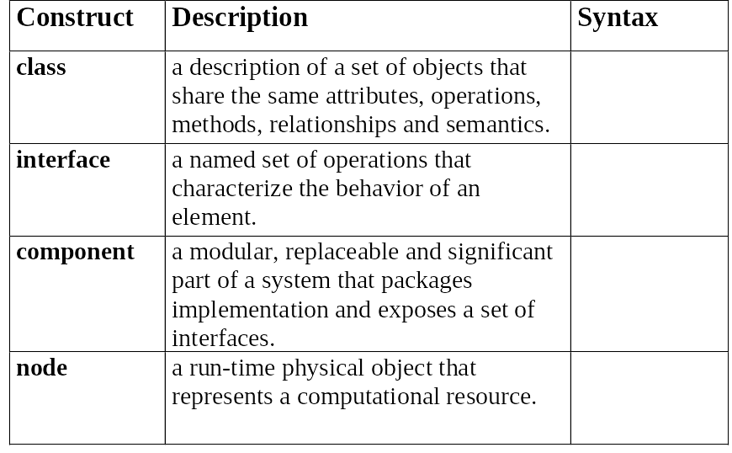
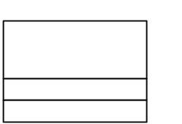

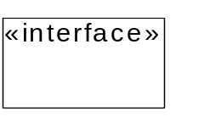
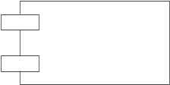
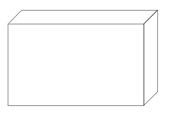
Structural Modeling: Core Elements

Slide 6
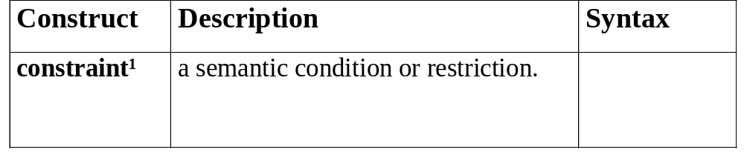
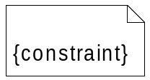
Structural Modeling: Core Elements (cont’d)
¹ An extension mechanism useful for specifying structural elements.

Slide 7
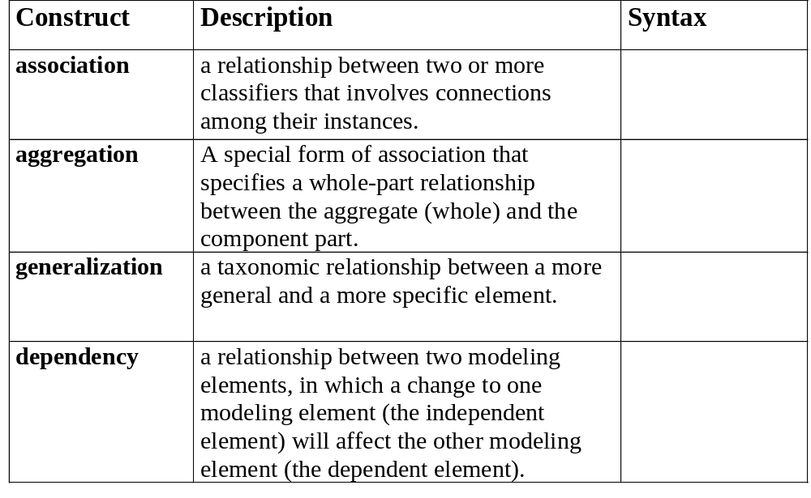
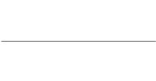




Structural Modeling: Core Relationships

Slide 8
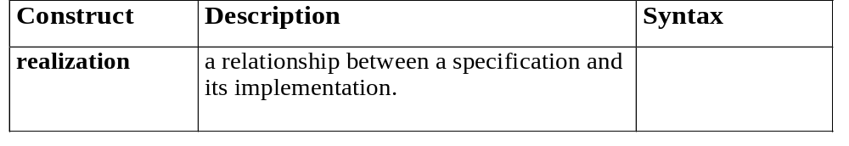

Structural Modeling: Core Relationships (cont’d)

Slide 9
Structural Diagram Tour
Show the static structure of the model
  the entities that exist (e.g., classes, interfaces, components, nodes)
  internal structure
  relationship to other entities
Do not show temporal information
Kinds
  static structural diagrams
    class diagram
    object diagram
  implementation diagrams
    component diagram
    deployment diagram

Slide 10
UML - Outline
Introduction
Structural modeling
  Static structural diagrams
    Class diagrams
    Object diagrams
  Implementation diagrams
    Component diagrams
    Deployment diagrams
Behavioral modeling
Advanced modeling

Slide 11
Static Structural Diagrams
Shows a graph of classifier elements connected by static relationships.
kinds
  class diagram: classifier view
  object diagram: instance view

Slide 12
UML - Outline
Introduction
Structural modeling
  Static structural diagrams
    Class diagrams
    Object diagrams
  Implementation diagrams
    Component diagrams
    Deployment diagrams
Behavioral modeling
Advanced modeling

Slide 13
Class
name
Window
origin
size
attributes
Open()
Close()
Move()
Display()
operations

Slide 14
Active class
EventManager
Thick boundary
Suspend()
Flush()

Slide 15
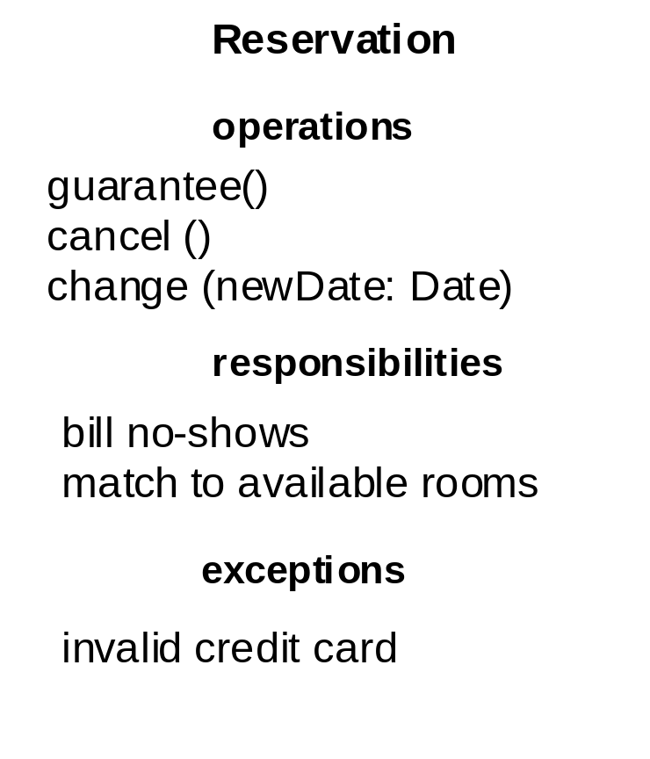
Classes: compartments with names
Fig. 3-23, UML Notation Guide

Slide 16
Classes with more details
PackageName::Agent
Name: simple, path
Height: Float
Val : Boolean = false
Attribute: all, only some, or none
<<constructor>>
New(p : policy)
<<process>>
Process(o : order)
…
Operations: services provided.
Stereotype: group attributes/ops and
put a descriptive prefix.
Responsibilities
Responsibility: obligation of a class.
free-form text.
-- determine risk of an
order
-- handle criteria for
fraud

Slide 17
Classifiers
A classifier is a mechanism for describing structural and behavioral features.
  Nine classifiers
    Classes, interfaces, datatypes, signals, components, nodes, use cases, subsystems.
  Advanced features
    Multiplicity, visibility, signatures, polymorphism

Slide 18
Visibility of a classifier’s attr. & ops.
Public: Any outside classifier can use (+).
Protected: Any descendant of the classifier can use (#).
Private: Only the classifier itself can use (-).
Toolbar
# currentSelection: Tool
# toolCount: Integer
+ pickItem(i: integer)
- compact()

Slide 19
(Owner) Scope
Instance: Each instance of the classifier holds its own value
for the feature.
Classifier: There is just one value of the feature for all
instances of the classifier.
Frame
instance
Header : FrameHeader
uniqueID : Long
classifier
(“static” in Java)

Slide 20
Multiplicity
- Specification of the range of allowable cardinalities
an entity may assume.
NetworkController
1
consolePort [2..*] : Port

Slide 21
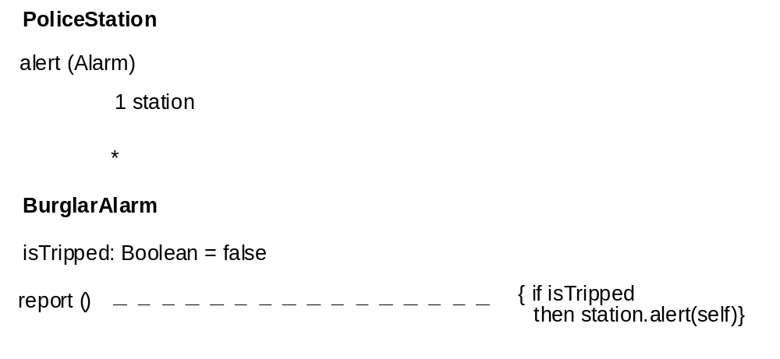
Classes: method body
Fig. 3-24, UML Notation Guide

Slide 22
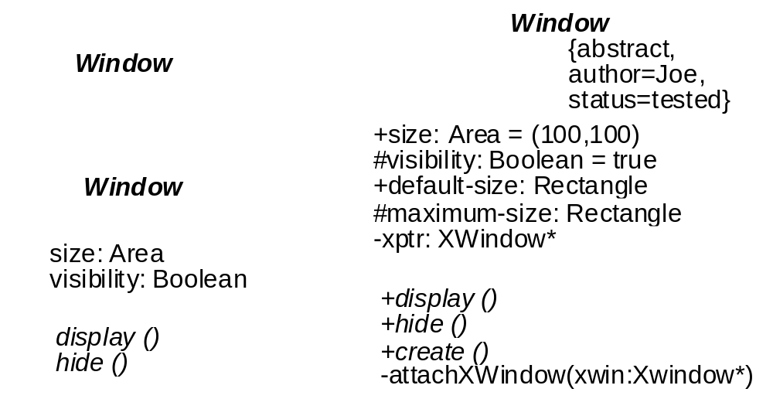
Showing more details...
Names of abstract classes and operations shown in italics
Fig. 3-20, UML Notation Guide

Slide 23
Relationships
Dependency:
    Use to show one thing using or deriving from another.
    Arrow in the direction of thing being depended on.
Generalization:
    Use to show a parent-child relationship.
    Child is substitutable for parent (not the other way!)
Association: (structural relationship)
    Objects of one thing are connected to another.
    Unary, binary, n-ary.

Slide 24
Relationships
Window
Open()
Close()
HandleEvent()
Event
dependency
generalization
association
ConsoleWindow
DialogBox
Control
DisplayPrompt()
…

Slide 25
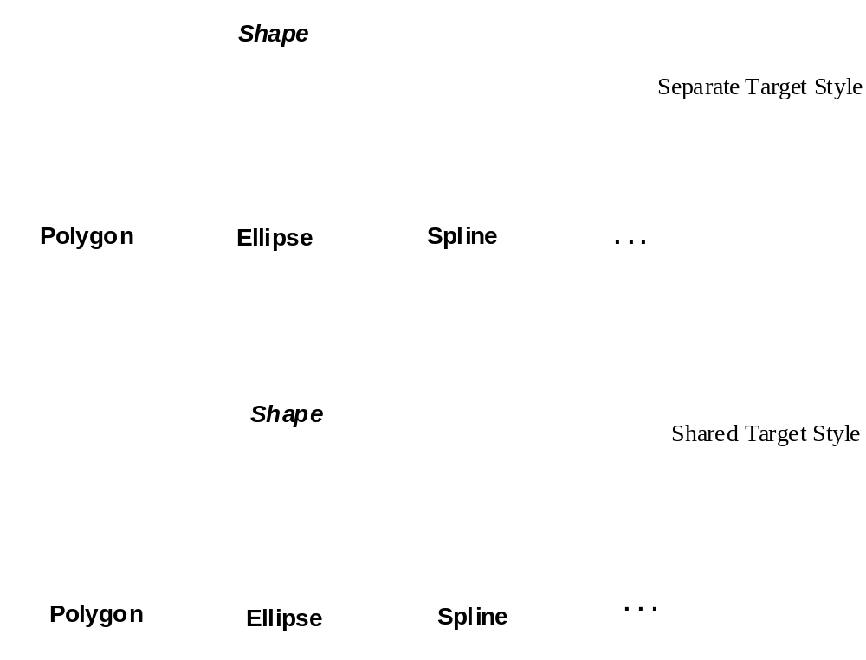
Generalization: Alternative notations
Fig. 3-47, UML Notation Guide

Slide 26
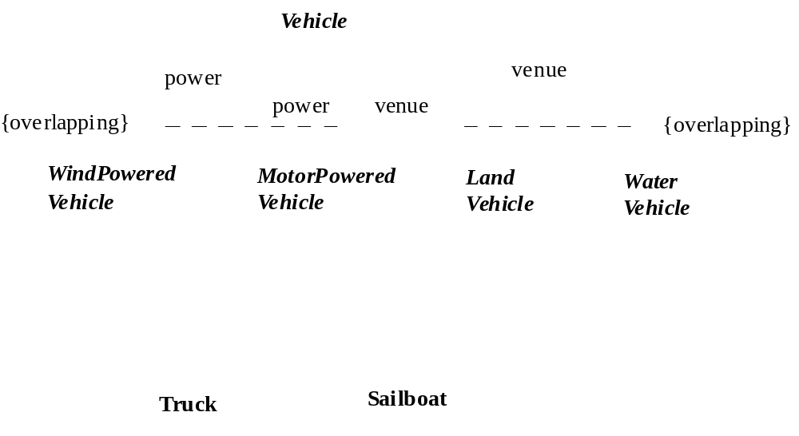
Generalization: Multiple Classification
Fig. 3-48, UML Notation Guide

Slide 27
More about association
Person
Works for
Company
Name an association to describe its nature.
Direction triangle: direction of reading.
employee
employer
Person
Company
Role: face presented to the other class.

Slide 28
More about association
Navigability: An arrow may be attached to the end of the path to
indicate that navigation is supported toward the classifier attached
to the arrow.
Works for
Person
Company

Slide 29
More about association
Multiplicity: How many objects may be connected across
an instance of an association.
1..*
Person
*
Company
employee
employer
Multiplicity at one end ➔ for each object at the other end,
there must be that many objects at the near end.
Exactly one: 1
Zero or one: 0 .. 1
Many: 0 .. *
One or more: 1 .. *
Not shown ➔ unspecified or suppressed

Slide 30
Aggregation
Plain association: peer relationship.
Aggregation: whole/part relationship.
- An object may be a part of ONLY one aggregate at a time.
Company
whole
1
*
Department
part

Slide 31
More about association
Composition (composite aggregation):
- An object may be a part of ONLY one composite at a time.
- Whole is responsible for the disposition of its parts.
Window
whole
1
*
Frame
part

Slide 32
Composition vs Aggregation
Aggregation: does not link the lifetimes of the whole and its parts.
Composition:
    Parts with nonfixed multiplicity can be created after the composite itself. ⬅ lifetime
    Such parts can be explicitly removed before the death of the composite. ⬅ lifetime
    An object may be a part of only one composite at a time. ⬅ strong ownership

Slide 33
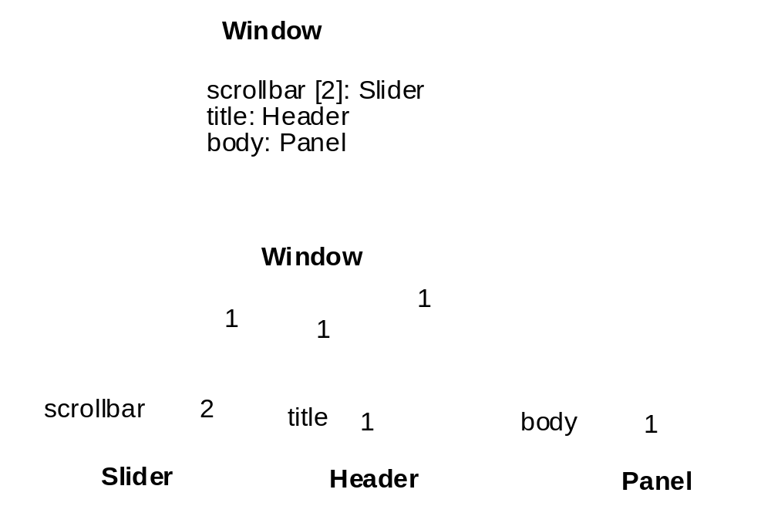
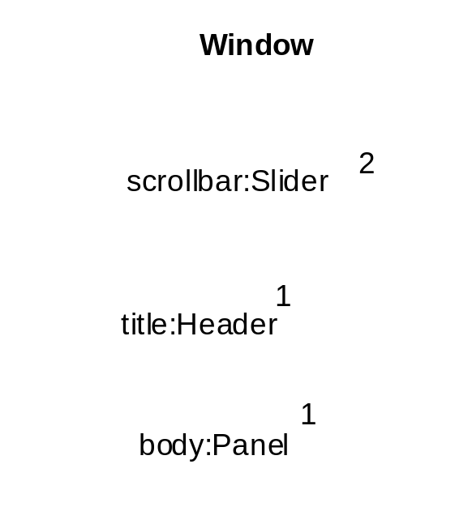
Alternative notations for composition
Fig. 3-45, UML Notation Guide
Fig. 3-45, UML Notation Guide

Slide 34
More about association
Association classes: specify properties of an association.
employer
employee
Company
Person
*
1..*
Job
Description
dateHired
Salary

Slide 35
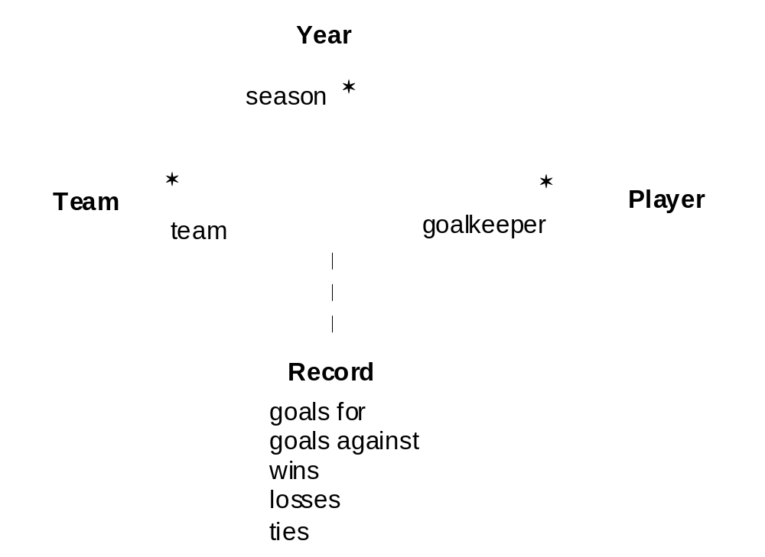
Ternary Associations
Fig. 3-44, UML Notation Guide

Slide 36
Constraints
Constraints add new semantics or change existing rules.
Portfolio
Corporation
{secure}
{or}
BankAccount
Person

Slide 37
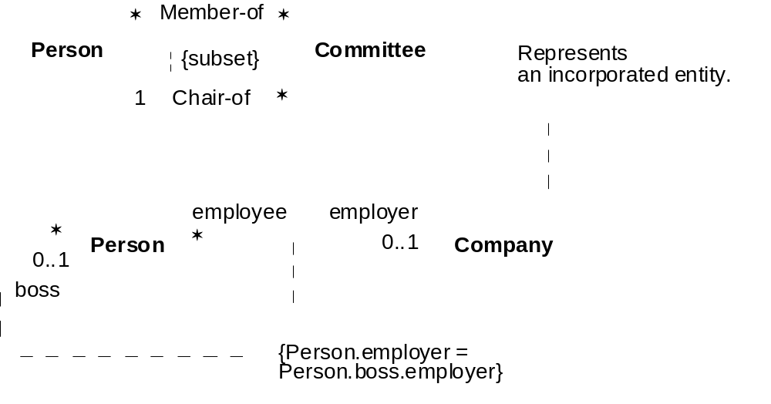
Constraints and Comments
Fig. 3-17, UML Notation Guide

Slide 38
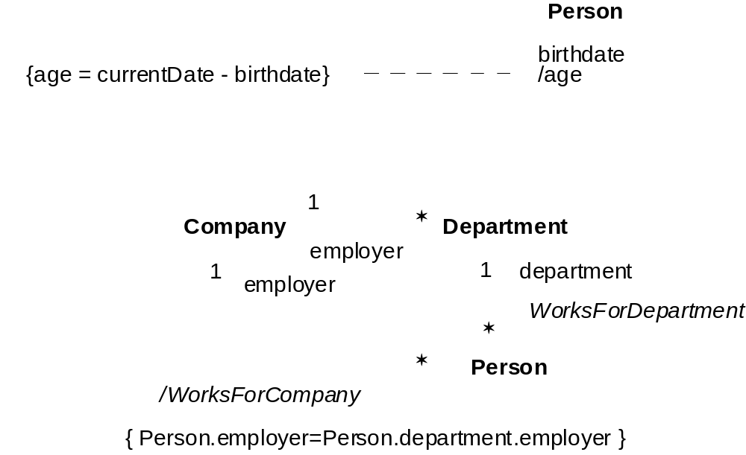
Derived Attributes and Associations
Fig. 3-52, UML Notation Guide

Slide 39
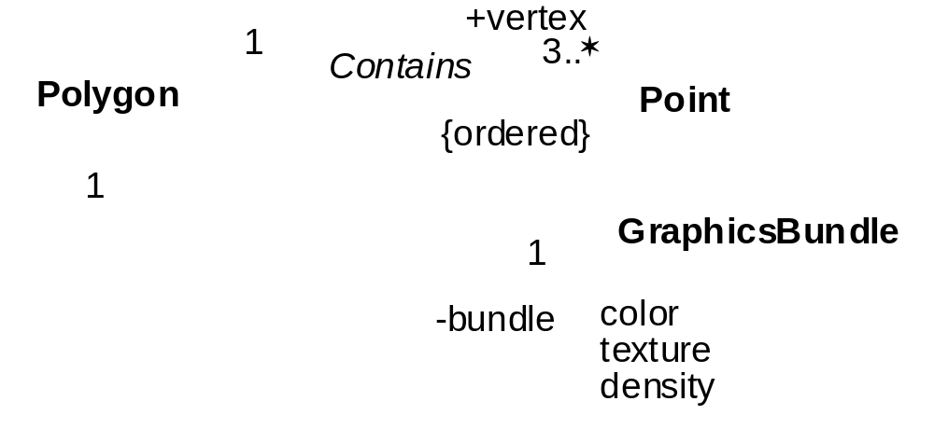
More examples of associations

Slide 40
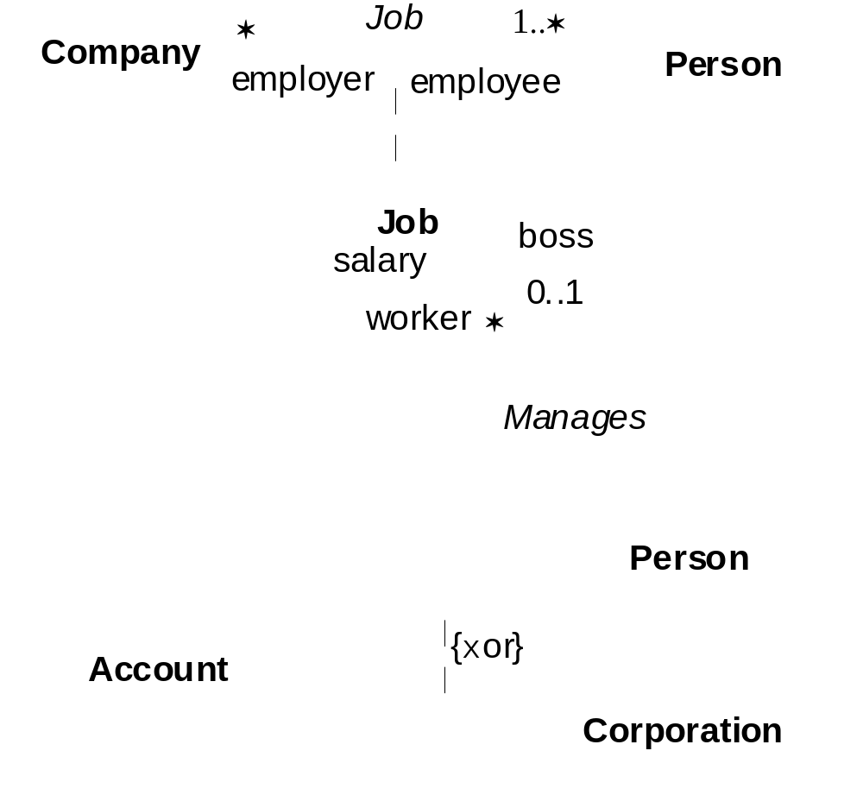
More examples of associations
Fig. 3-40, UML Notation Guide

Slide 41
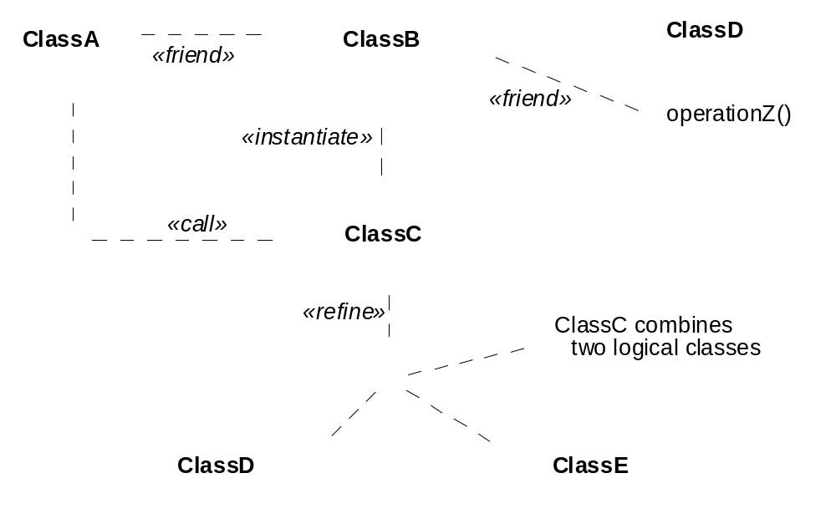
Dependencies
Fig. 3-50, UML Notation Guide

Slide 42
Realization
- A semantic relationship between classifiers.
- One classifier specifies a contract that another guarantees.
- Realization in two places:
- between interfaces and classes/components that
realize them.
- between use cases and collaborations that realize
them.
- Graphical rendering: cross between generalization and
dependency

Slide 43
Interface
Defines a set of operation specs
Never defines an implementation
(no attributes, no associations, operations not implemented)
Typically attached to a class or component

Slide 44
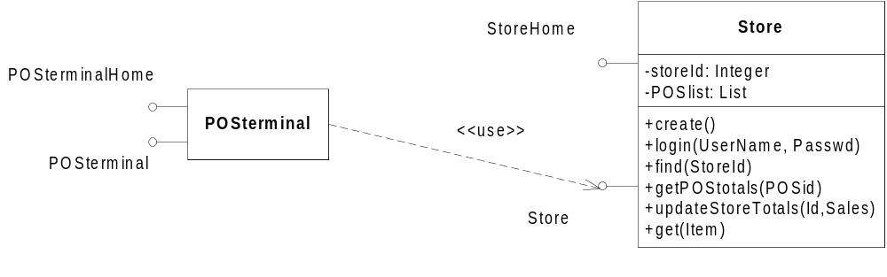
Interfaces: Shorthand Notation
I
I
Fig. 3-29, UML Notation Guide

Slide 45
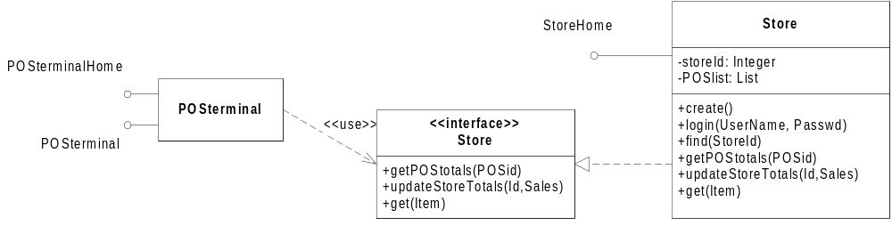
Interfaces: Longhand Notation
I
I
Fig. 3-29, UML Notation Guide

Slide 46
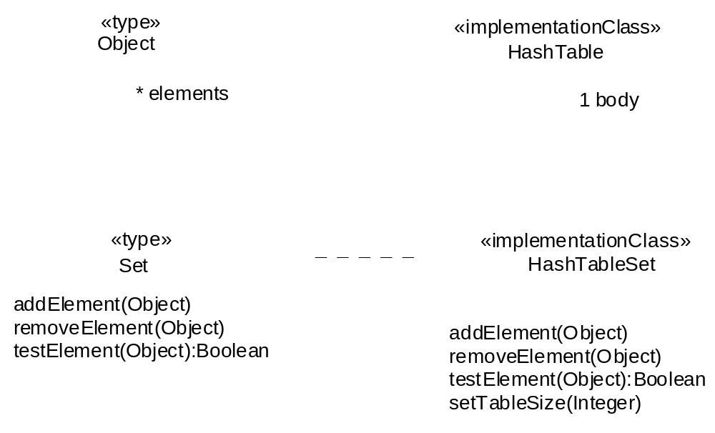
Types and Implementation Classes
Fig. 3-27, UML Notation Guide

Slide 47
Type
Like an interface: Defines a set of operation specs
Unlike an interface: Can have attributes and associations

Slide 48
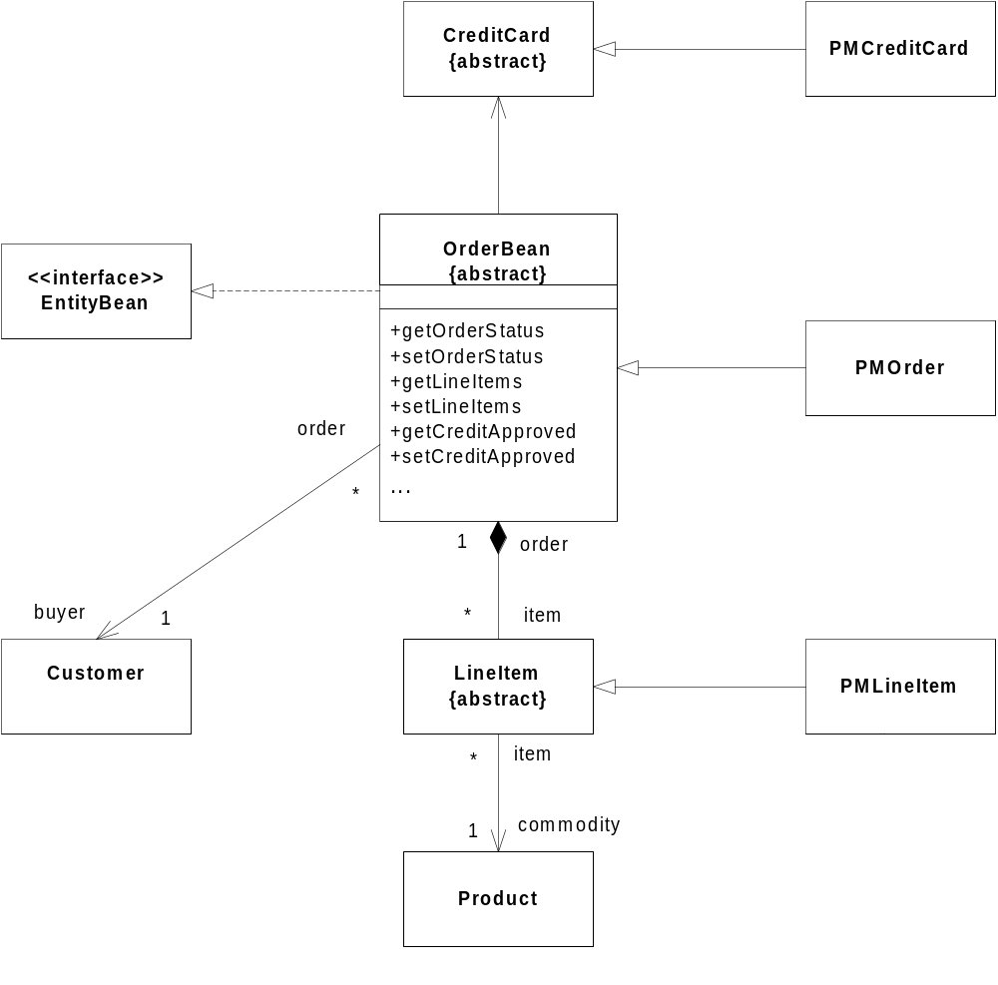
Class Diagram Example
Adapted from Fig. 23 [EJB 2.0].

Slide 49
Not discussed...
Associations with qualification
Associations with roles and interface specification
  See UML User Guide, p. 145ff

Slide 50
UML - Outline
Introduction
Structural modeling
  Static structural diagrams
    Class diagrams
    Object diagrams
  Implementation diagrams
    Component diagrams
    Deployment diagrams
Behavioral modeling
Advanced modeling

Slide 51
Instances
Concrete manifestation of an abstraction
All objects are instances
Not all instances are objects. (Instance of an association is a “link”)
To indicate an instance, underline its name

Slide 52
Instances (named, anonymous, multiple)
t: Transaction
named
myCustomer
:Multimedia::AudioStream
anonymous
multiobject
:keyCode

Slide 53
Object state
myCustomer
Instance with attribute values
Id : SSN = “432 …..”
Active = true
Instance with explicit state
c: Phone
[WaitingForAnswer]

Slide 54
Object diagrams
Model the instances of things contained in class diagrams.
Show objects are their relationships at a point in time.
No communication is shown.

Slide 55
An object diagram
c:Company
d1: Dept
d2: Dept
name = “Sales”
name = “R&D”
d3: Dept
Objects, links, notes, constraints
Name = ….
p: Person
: ContactInfo
Name = “jk”
Address=“200 U Av.”

Slide 56
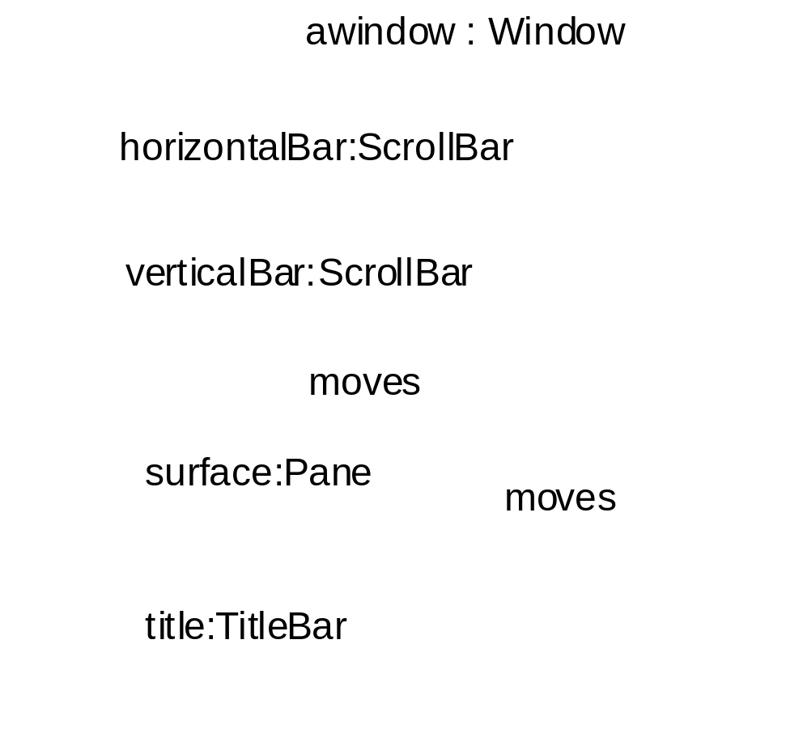
Composite objects
Fig. 3-39, UML Notation Guide

Slide 57
UML - Outline
Introduction
Structural modeling
  Static structural diagrams
    Class diagrams
    Object diagrams
  Implementation diagrams
    Component diagrams
    Deployment diagrams
Behavioral modeling
Advanced modeling

Slide 58
Implementation Diagrams
Show aspects of model implementation, including source code structure and run-time implementation structure
Kinds
  component diagram
  deployment diagram

Slide 59
UML - Outline
Introduction
Structural modeling
  Static structural diagrams
    Class diagrams
    Object diagrams
  Implementation diagrams
    Component diagrams
    Deployment diagrams
Behavioral modeling
Advanced modeling

Slide 60
Component Diagram
Shows the organizations and dependencies among software components
Component
  a modular, replaceable and significant part of a system that packages implementation and exposes a set of interfaces
Components may be
  implemented by artifacts (e.g., binary, executable, or script files)

Slide 61
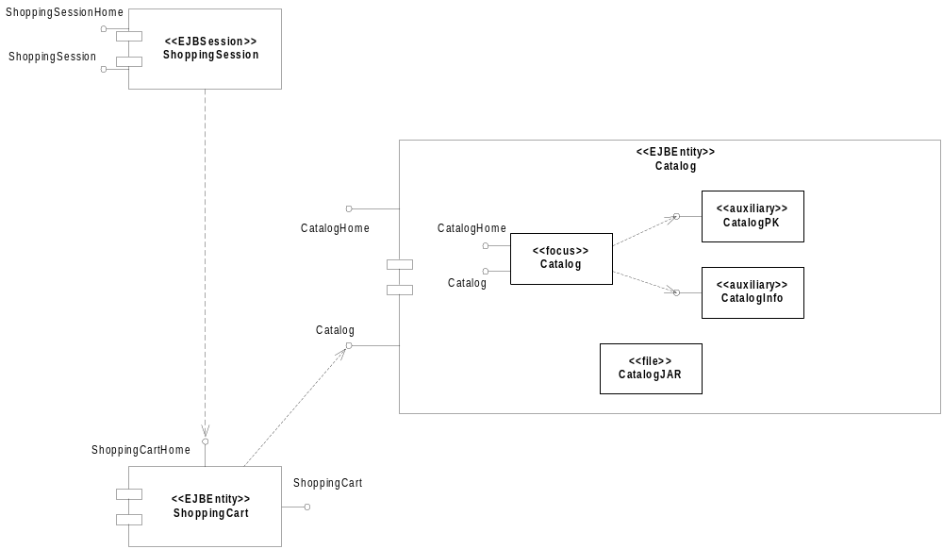
Component Diagram
Fig. 3-95, UML Notation Guide

Slide 62
UML - Outline
Introduction
Structural modeling
  Static structural diagrams
    Class diagrams
    Object diagrams
  Implementation diagrams
    Component diagrams
    Deployment diagrams
Behavioral modeling
Advanced modeling

Slide 63
Deployment Diagram
Shows the configuration of run-time processing elements and the software components, processes and objects that live on them
Deployment diagrams may be used to show which components may run on which nodes

Slide 64
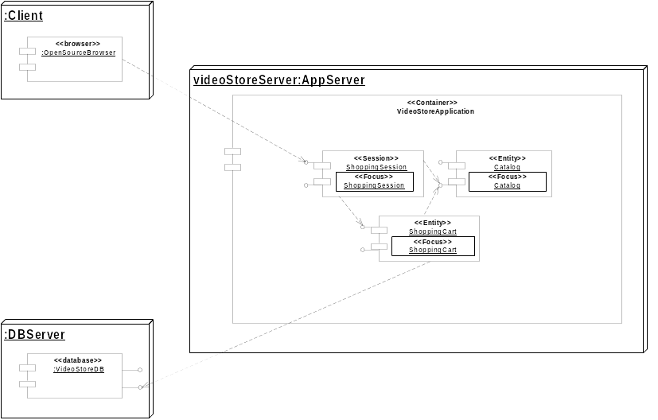
Deployment Diagram
Fig. 3-97, UML Notation Guide

